Slide 1


WeDash
BANK
ANALYSIS
DATA
Team: Sparks
Members:
Aaghash M
Sanjey G M
Maniraj T

Slide 2
Table of Contents
The visualizations should depict how top 5 players performed in terms on POS spends, ECOM spends and ATM withdrawal.
How many outstanding debit cards does the market leader and market challenger have?
Which month shows highest POS, ECOM and ATM withdrawal in India in terms of count and amount for year 2023. What could be the reason for same?
What is the analysis on the market leaders across the categories?
Points for discussion

Slide 3

Introduction
In this presentation, we try to provide a comprehensive analysis of a rich bank dataset, focusing on the intricate dynamics of Point of Sale (POS), Automated Teller Machine (ATM), and E-commerce transactions. By delving into this dataset, we aim to unravel trends, patterns, and correlation on consumer behavior, economic activity, and the evolving landscape of digital transactions in the banking sector.

Slide 4
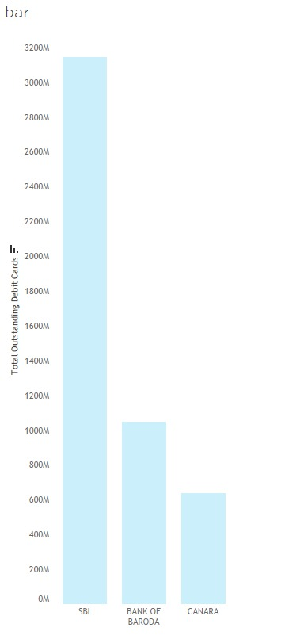
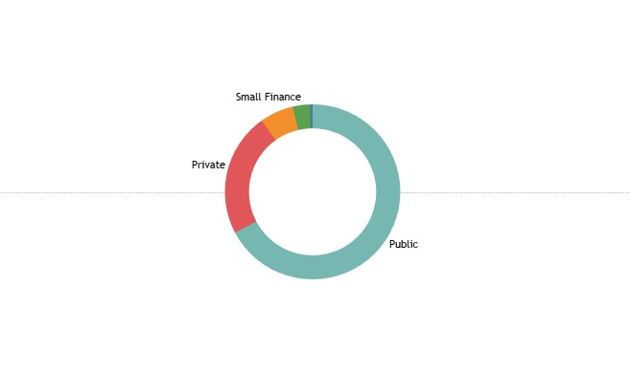
Top Sectors by no. of Debit Cards
Points for discussion
Public Sector: Debit card usage is prominent among Government employees and beneficiaries frequently utilize debit cards for salary disbursements, welfare schemes, and government-related expenses.
Private Sector: While employees and customers of private enterprises, encompassing industries such as technology, manufacturing, and services use them lesser.
Small Finance Sector: Debit cards play a crucial role in facilitating financial transactions for individuals and businesses served by small finance banks and institutions, fostering financial inclusion and accessibility.

Slide 5
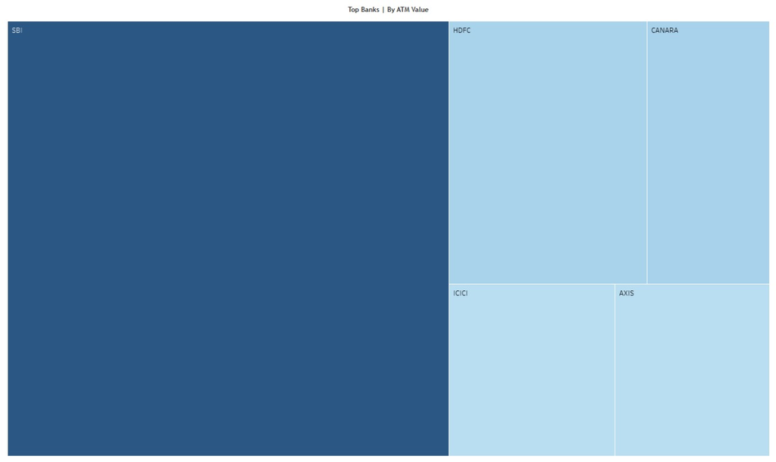
SBI, as one of the largest public sector banks in India, commands a significant share of the ATM transaction market.
There are various ATM transaction value of SBI, highlighting its extensive network, customer reach, and strategic initiatives aimed at enhancing ATM services and accessibility.
HDFC Bank:
While HDFC Bank being is one of the leading private sector banks renowned for its innovative banking solutions and extensive ATM network.
Exploring the ATM transaction value of HDFC Bank, emphasizing its customer-centric approach, technological advancements, and efforts to shows ATM user experience.
Canara Bank, a prominent public sector bank, boasts a widespread presence across the country and offers a range of banking services, including ATM facilities.
Delving into the ATM transaction value of Canara Bank, highlighting its market penetration, service offerings, and strategies to cater to diverse customer segments.

Slide 6
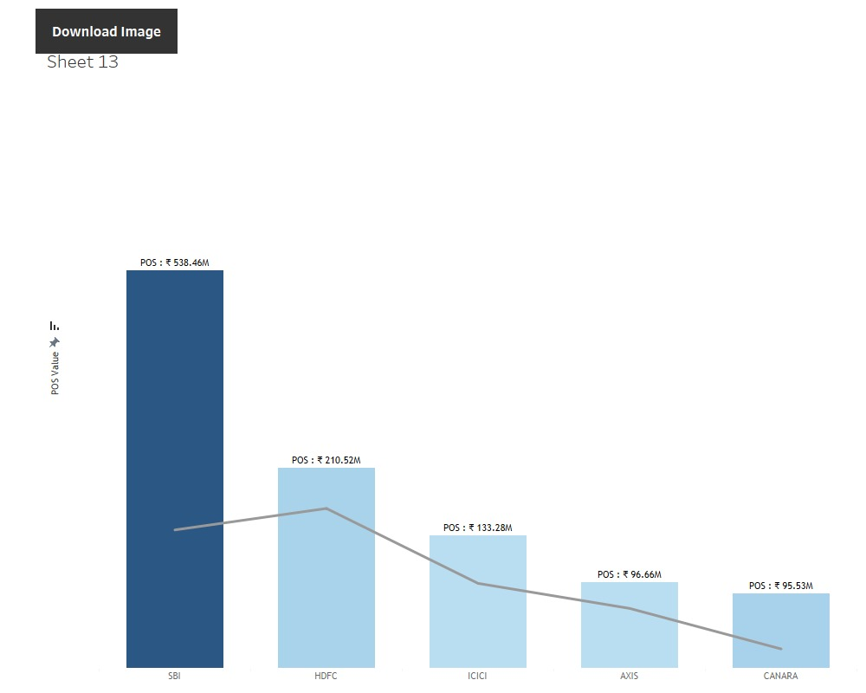

 | Relation between POS transactions and outstanding debit cards
Increased POS transactions often lead to higher outstanding debit card balances.
Frequent use of debit cards at POS terminals can contribute to higher levels of consumer debt.
While ECOM values is not a consistent measure of relating the values as seen in the below chart

Slide 7



















Thank You

